Slide 1
Encapsulation
Till here, our data was all exposed!
theCat.height = 27 ;
=> theCat.height = 0 ;
public void setHeight(int ht)
{
if(ht > 9){
height = ht;
}
}
Notes:
1

Slide 2
Encapsulation = hide the data
How exactly do we hide the data?
- using access modifiers
eg. public & private
Mark instance variables private
Mark getters and setters public
Notes:
2

Slide 3
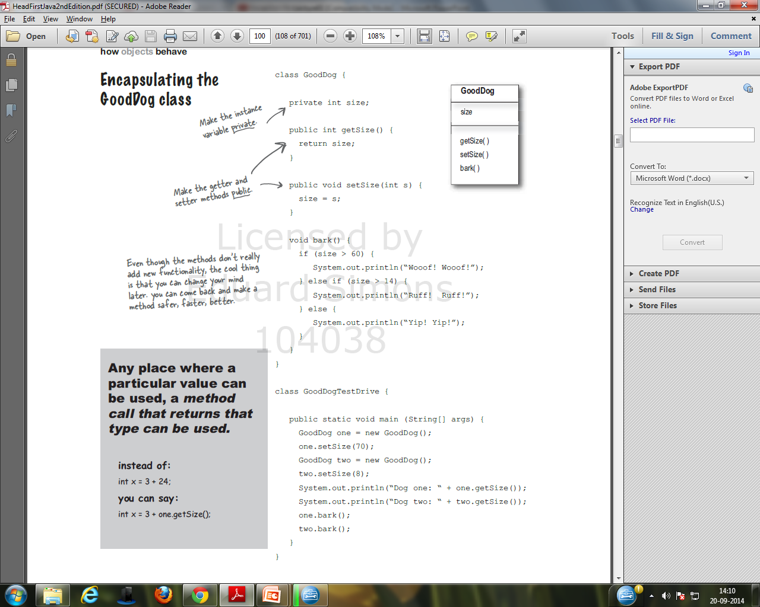
Notes:
3

Slide 4
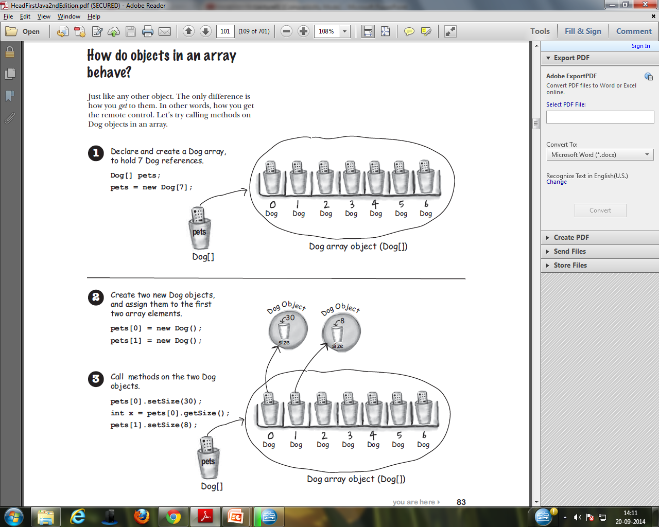
Notes:
4

Slide 5
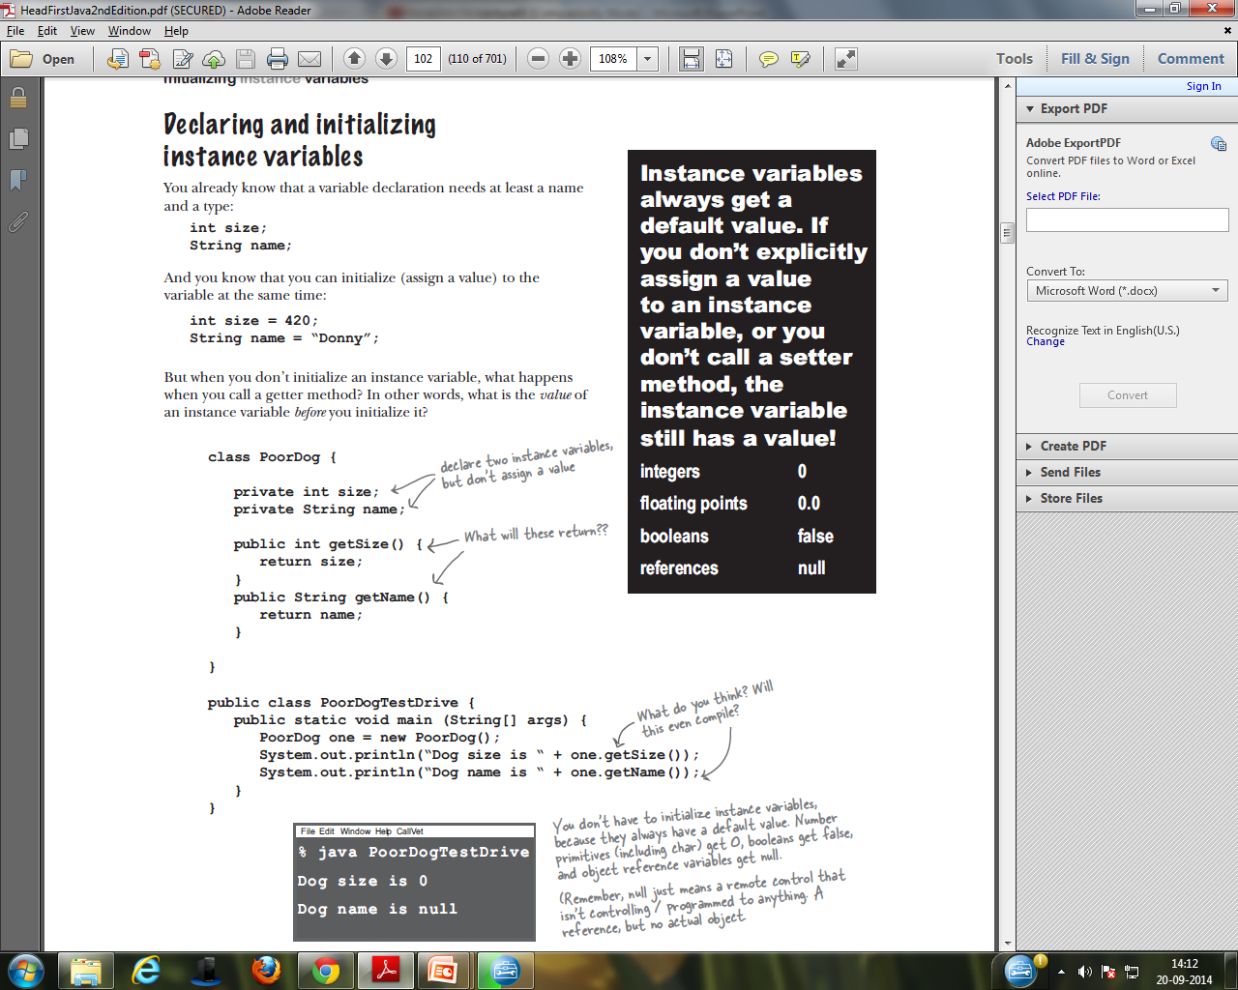
Notes:
5

Slide 6
Constructors
Constructors have the following characteristics:
➤ They are called when the class is being instantiated.
➤ They must have the same name as the class they’re in.
➤ They can’t return a value and you don’t specify the keyword void as a return type.
Notes:
6

Slide 7
Class Tax with constructor
class Tax {
double grossIncome; // class variables
String state;
int dependents;
// Constructor
Tax (double gi, String st, int depen){
grossIncome = gi; // class variable initialization
state = st;
dependents=depen;
}
}
Creating an instance of this class can look like this:
Tax t = new Tax(65000,”NJ”,3);
Tip:
If a constructor with arguments has been
defined in a class, you can no longer use a default no-argument constructor — ​you have to explicitly
write one if needed.
Notes:
7

Slide 8
Difference between Default and parameterized constructor
Default constructor | Parameterized constructor
Useful to initialize all objects with same data | Useful to initialize each object with different data
Does not have any parameters | One or more parameters
When data is not passed at the time of creating an object, default constructor is called. | When data is passed at the time of creating an object, parameterized constructor is called.
Notes:
8

Slide 9
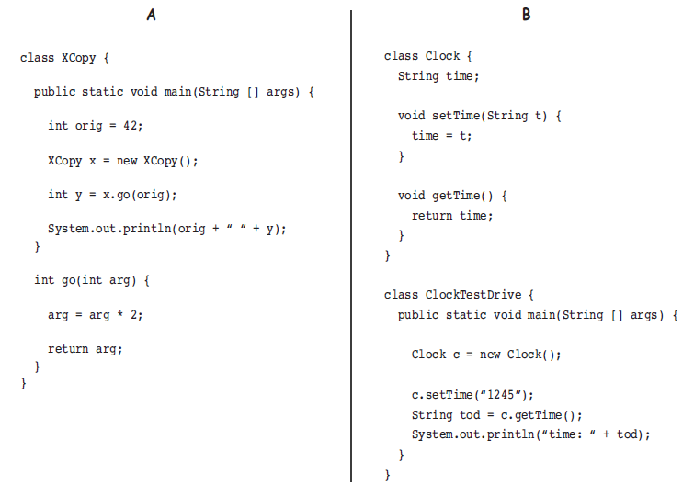
Be the compiler!
Notes:
9

Slide 10
Passing Information to a Method or a Constructor
You can use any data type for a parameter of a method or a constructor. This includes primitive data types, such as doubles, floats, and integers and reference data types, such as objects and arrays.
You can use a construct called varargs to pass an arbitrary number of values to a method, when you don't know how many of a particular type of argument will be passed to the method
To use varargs, follow the type of the last parameter by an ellipsis (three dots, ...), then a space, and the parameter name.
Ex:
public Polygon polygonFrom(Point... corners)
{
int numberOfSides = corners.length;
double squareOfSide1, lengthOfSide1;
squareOfSide1 = (corners[1].x - corners[0].x) * (corners[1].x - corners[0].x) + (corners[1].y - corners[0].y) * (corners[1].y - corners[0].y);
lengthOfSide1 = Math.sqrt(squareOfSide1); // more method body code follows that creates and returns a
// polygon connecting the Points
}

Slide 11
inheritance

Slide 12
Java modifiers
Modifiers are keywords that you add to those definitions to change their meanings.
Access Modifiers: public , protected, private, default
Java provides a number of access modifiers to set access levels for classes, variables, methods and constructors. The four access levels are:
Visible to the package, the default. No modifiers are needed.
Visible to the class only (private).
Visible to the world (public).
Visible to the package and all subclasses (protected).
Non-access Modifiers: static,final, abstract, strictfp
Java provides a number of non-access modifiers to achieve many other functionality.
The static modifier for creating class methods and variables
The final modifier for finalizing the implementations of classes, methods, and variables.
The abstract modifier for creating abstract classes and methods.
The synchronized and volatile modifiers, which are used for threads.

Slide 13
enums
Enums were introduced in java 5.0.
Enums restrict a variable to have one of only a few predefined values. The values in this enumerated list are called enums.
With the use of enums it is possible to reduce the number of bugs in your code.
For example, if we consider an application for a fresh juice shop, it would be possible to restrict the glass size to small, medium and large. This would make sure that it would not allow anyone to order any size other than the small, medium or large.

Slide 14
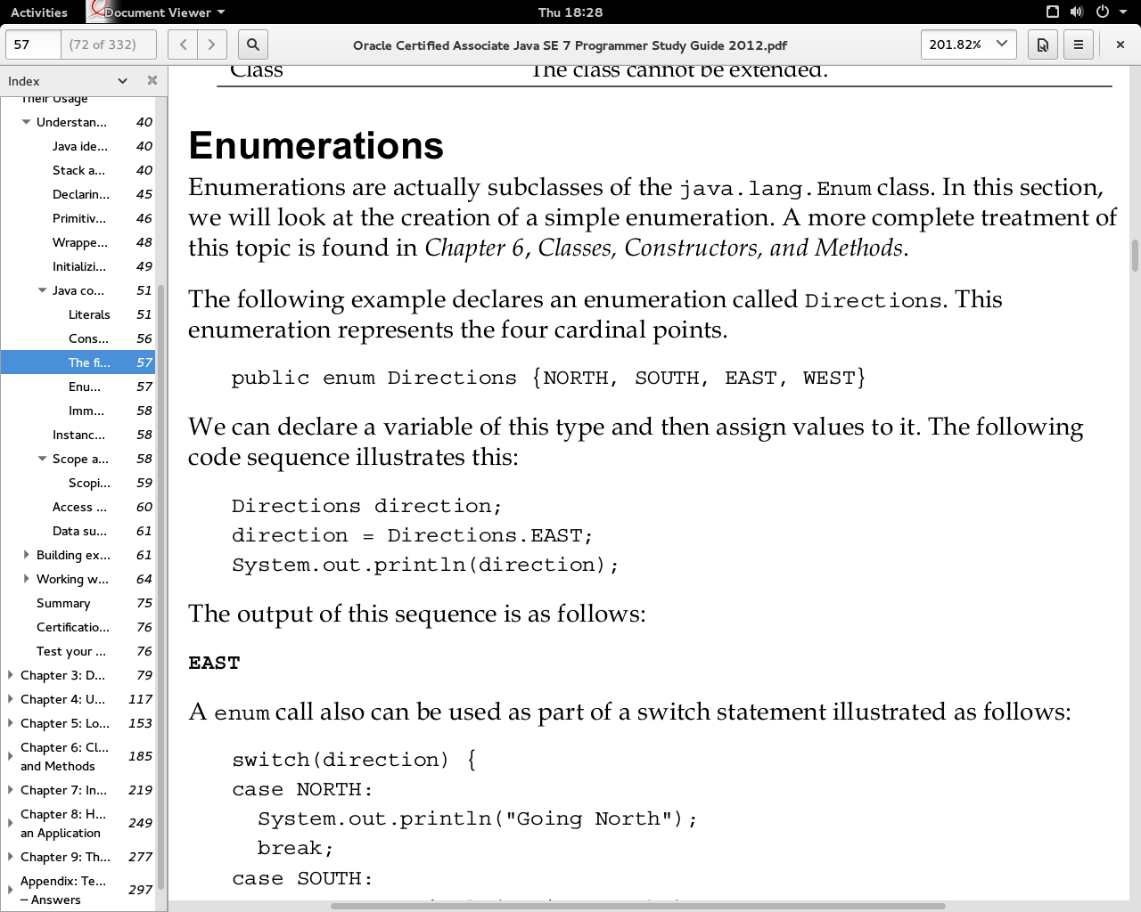
Enumerations
Enumerations are actually subclasses of the java.lang.Enum class.

Slide 15
Enumeration as switch
switch(direction) {
case north:
System.out.println("going north");
break;
case south:
System.out.println("going south");
break;
case east:
System.out.println("going east");
break;
case west:
System.out.println("going west");
break;
}

Slide 16
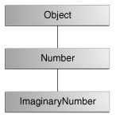
Covariant return type
When a method uses a class name as its return type, the class of the type of the returned object must be either a subclass of, or the exact class of, the return type.
suppose that you have a method declared to return a Number:
public Number returnANumber() { ... }
The returnANumber method can return an ImaginaryNumber but not an Object
override a method and define it to return a subclass of the original method, like this:
public ImaginaryNumber returnANumber() { ... }
This technique, called covariant return type, means that the return type is allowed to vary in the same direction as the subclass.

Slide 17
Java modifiers
Modifiers are keywords that you add to those definitions to change their meanings.
Access Modifiers: public , protected, private, default
Java provides a number of access modifiers to set access levels for classes, variables, methods and constructors. The four access levels are:
Visible to the package, the default. No modifiers are needed.
Visible to the class only (private).
Visible to the world (public).
Visible to the package and all subclasses (protected).
Non-access Modifiers: static, final, abstract, strictfp
Java provides a number of non-access modifiers to achieve many other functionality.
The static modifier for creating class methods and variables
The final modifier for finalizing the implementations of classes, methods, and variables.
The abstract modifier for creating abstract classes and methods.
The synchronized and volatile modifiers, which are used for threads.

Slide 18
enums
Enums were introduced in java 5.0.
Enums restrict a variable to have one of only a few predefined values. The values in this enumerated list are called enums.
With the use of enums it is possible to reduce the number of bugs in your code.
For example, if we consider an application for a fresh juice shop, it would be possible to restrict the glass size to small, medium and large. This would make sure that it would not allow anyone to order any size other than the small, medium or large.

Slide 19
Enumerations
Enumerations are actually subclasses of the java.lang.Enum class.

Slide 20
Enumeration as switch
switch(direction) {
case north:
System.out.println("going north");
break;
case south:
System.out.println("going south");
break;
case east:
System.out.println("going east");
break;
case west:
System.out.println("going west");
break;
}

Slide 21
Garbage collector
Garbage means unreferenced objects.
Garbage collection (GC) is a form of automatic memory management
attempts to reclaim garbage, or memory occupied by objects that are no longer in use by the program
The basic principles of garbage collection are:
Find data objects in a program that cannot be accessed in the future
Reclaim the resources used by those objects
Advantages:
It makes java memory efficient because garbage collector removes the unreferenced objects from heap memory.
It is automatically done by the garbage collector so we don't need to make extra efforts.
An object is unreferenced in number of ways
By nulling the reference Employee e1=new Employee(); e1=null;
By assigning a reference to another
By annonymous object etc. (new Employee(); )
The finalize() method is invoked each time before the object is garbage collected
The gc() method is used to invoke the garbage collector to perform cleanup processing. The gc() is found in System and Runtime classes.
Garbage collection is performed by a daemon thread called Garbage Collector(GC). This thread calls the finalize() method before object is garbage collected.
Employee e1=new Employee();
Employee e2=new Employee();
e2=e1;

Slide 22
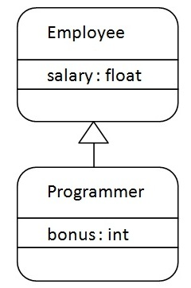
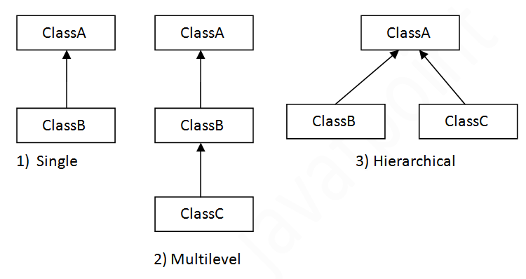
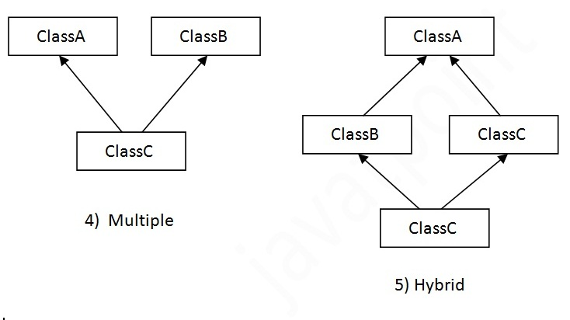
Inheritance
Inheritance is a mechanism in which one object acquires all the properties and behaviours of parent object. Type of relationship is “is-a”. Java uses “super” keyword.
Advantages:
For Method Overriding (So Runtime Polymorphism).
For Code Reusability.
Syntax: class Subclass-name extends Superclass-name
{
//methods and fields
}
Types of Inheritance
public class Animal{ }
public class Mammal extends Animal{ }
public class Reptile extends Animal{ }
public class Dog extends Mammal{ }
Base/super/parent class
Derived/sub
/child class

Slide 23
Aggregation
If a class have an entity reference, it is known as Aggregation
Type of relationship is “has-a”.
Example: class Employee{
int id;
String name;
Address address;//Address is a class
...
}
Dependency
A class is dependent on an object of another class.
Type of relationship is “uses-a”.

Slide 24
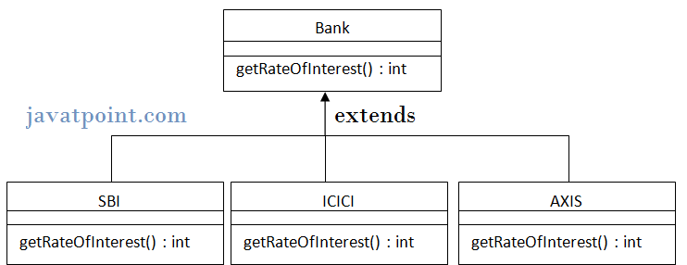
Method overriding
If subclass (child class) has the same method as declared in the parent class, it is known as method overriding.
Advantages:
provide specific implementation of a method that is already provided by its super class.
for Runtime Polymorphism
Rules for Method Overriding
method must have same name as in the parent class
method must have same parameter as in the parent class.
must be IS-A relationship (inheritance).
Method Overloading | Method Overriding
1) Method overloading is used to increase the readability of the program. | Method overriding is used to provide the specific implementation of the method that is already provided by its super class.
2) method overloading is performed within a class. | Method overriding occurs in two classes that use inheritance.
3) In case of method overloading parameter must be different. | In case of method overriding parameter must be same.

Slide 25
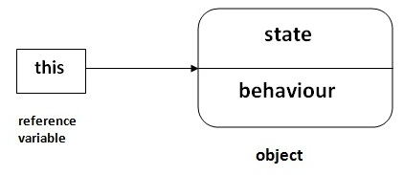
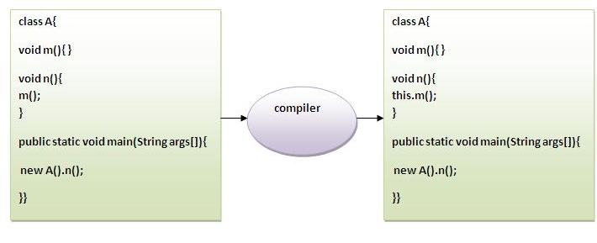
this Keyword
this keyword can be used as follows:
to refer current class instance variable.
to invoke current class constructor.
to invoke current class method (implicitly)
this can be passed as an argument in the method call.
this can be passed as argument in the constructor call.
to return the current class instance
Uses:
to reuse the constructor in the constructor
Call to this() must be the first statement in constructor.

Slide 26
Constructor Overloading
public studentrecord(){
//some initialization code here
}
public studentrecord(String temp){
this.name = temp;
}
public studentrecord(String name, String address){
this.name = name;
this.address = address;
}
public studentrecord(double mgrade, double egrade, double sgrade){
mathgrade = mgrade;
englishgrade = egrade;
sciencegrade = sgrade;
}

Slide 27
Using Constructors
to use these constructors, we have the following code,
public static void main( string[] args ){
//create three objects for student record
studentrecord annarecord=new studentrecord("anna");
studentrecord beahrecord=new studentrecord("beah“,"philippines");
studentrecord crisrecord=new studentrecord(80,90,100);
//some code here
}

Slide 28
“this” constructor call
constructor calls can be chained, meaning, you can call another constructor from inside another constructor.
we use the this() call for this
there are a few things to remember when using the this() constructor call:
– when using the this constructor call, it must occur as the
first statement in a constructor
– it can only be used in a constructor definition. the
this call can then be followed by any other relevant statements.

Slide 29
The Keyword THIS
The keyword this is useful when you need to refer to the instance of the class from its method.
Example :
class Tax {
double grossIncome; // class member variables
String state;
int dependents;
// Constructor
Tax (double grossIncome, String state, int dependents){
this.grossIncome = grossIncome; // instance variable initialization
this.state = state;
this.dependents=dependents;
}
}
Notes:
29

Slide 30
Usage of Java this keyword
Here is given the 6 usage of java this keyword.
this keyword can be used to refer current class instance variable.
this() can be used to invoke current class constructor.
this keyword can be used to invoke current class method (implicitly)
this can be passed as an argument in the method call.
this can be passed as argument in the constructor call.
this keyword can also be used to return the current class instance.
Suggestion: If you are beginner to java, lookup only two usage of this keyword.
Notes:
30

Slide 31
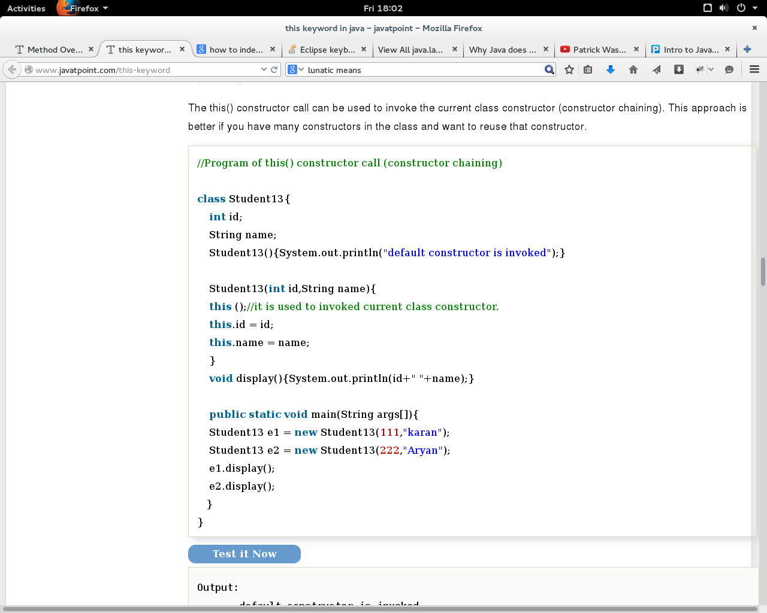
2. this() - to invoke current class constructor
Notes:
31

Slide 32
3. use this() for constructor chaining
The this() constructor call should be used to reuse the constructor in the constructor. It maintains the chain between the constructors i.e. it is used for constructor chaining.
class Student14{
int id; String name;
String city;
Student14(int id,String name){
this.id = id;
this.name = name;
}
Student14(int id,String name,String city){
this(id,name);//no need to initialize id and name
this.city=city;
}
void display(){
System.out.println(id+" "+name+“ "+city);}
public static void main(String args[]){
Student14 e1 = new Student14(111,"karan");
Student14 e2 = new Student14(222,"Aryan","delhi");
e1.display();
e2.display();
}
}
Rule:
Call to this() must be the first statement in constructor
Notes:
32

Slide 33
4. this keyword can be passed as an argument in the method.
It is mainly used in the event handling
Example
class S2{ void m(S2 obj){
System.out.println("method is invoked");
}
void p(){
m(this);
}
public static void main(String args[]){
S2 obj = new S2();
obj.p();
}
}
Notes:
33

Slide 34
5. The this keyword can be used to return current class instance.
Syntax
return_type method_name()
{
return this;
}
Example :
class A{
A getA() {
return this;
}
void msg() {
System.out.println("Hello java"); }
}
class Test1{
public static void main(String args[])
{
new A().getA().msg();
}
}
Notes:
34

Slide 35
“this” reference
The this reference
– refers to current object instance itself
– used to access the instance variables shadowed by the parameters.
To use the this reference, we type,
this.<nameOfTheInstanceVariable>
You can only use the this reference for instance variables and NOT static or class variables.

Slide 36
“this” reference
The this reference is assumed when you call a method from the same object
public class MyClass {
void aMethod() {
// same thing as this.anotherMethod()
anotherMethod();
}
void anotherMethod() {
// method definition here...
}
}
Example:
public void setAge( int age ){
this.age = age;
}

Slide 37
Static keyword
The static keyword is used in java mainly for memory management.
The static can be:
variable (also known as class variable)
method (also known as class method)
block
nested class
static method
A static method belongs to the class rather than object of a class.
A static method can be invoked without the need for creating an instance of a class.
static method can access static data member and can change the value of it.
Restrictions:
The static method can not use non static data member or call non-static method directly.
this and super cannot be used in static context.
Static block
Is used to initialize the static data member.
It is executed before main method at the time of class loading.

Slide 38
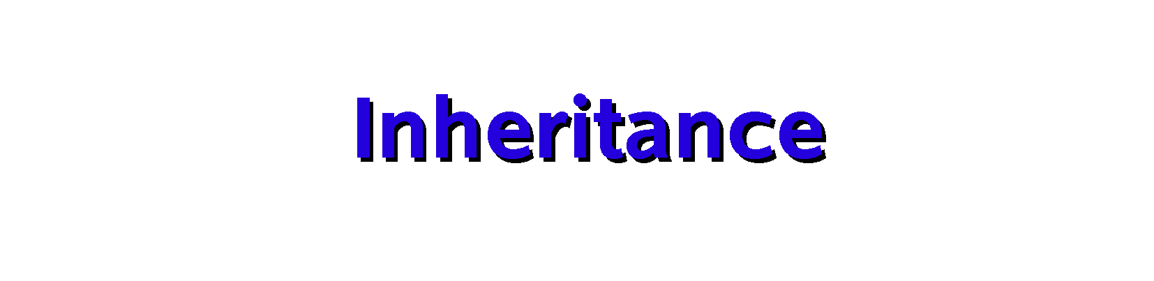

Slide 39
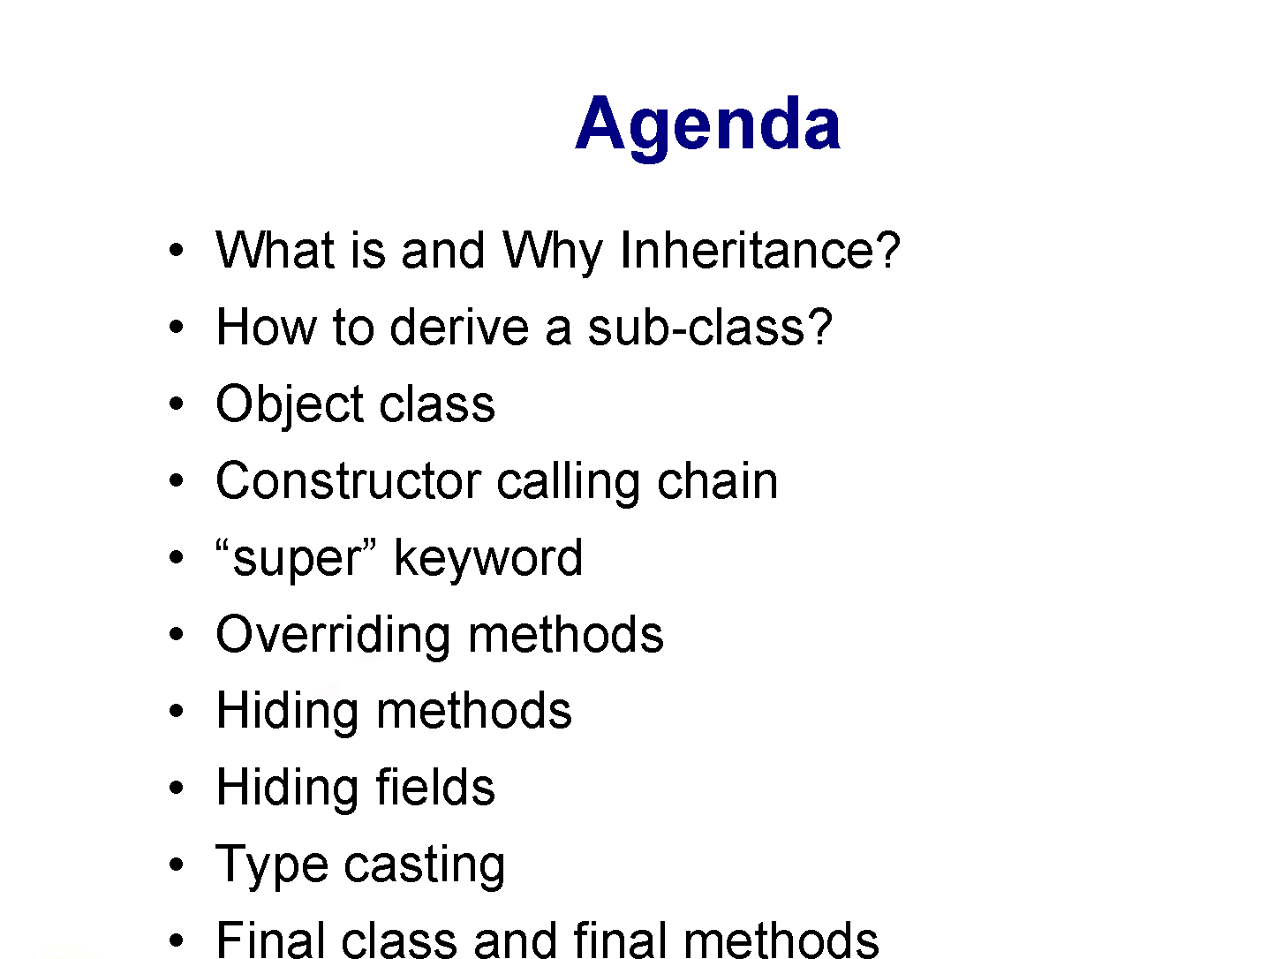

Slide 40
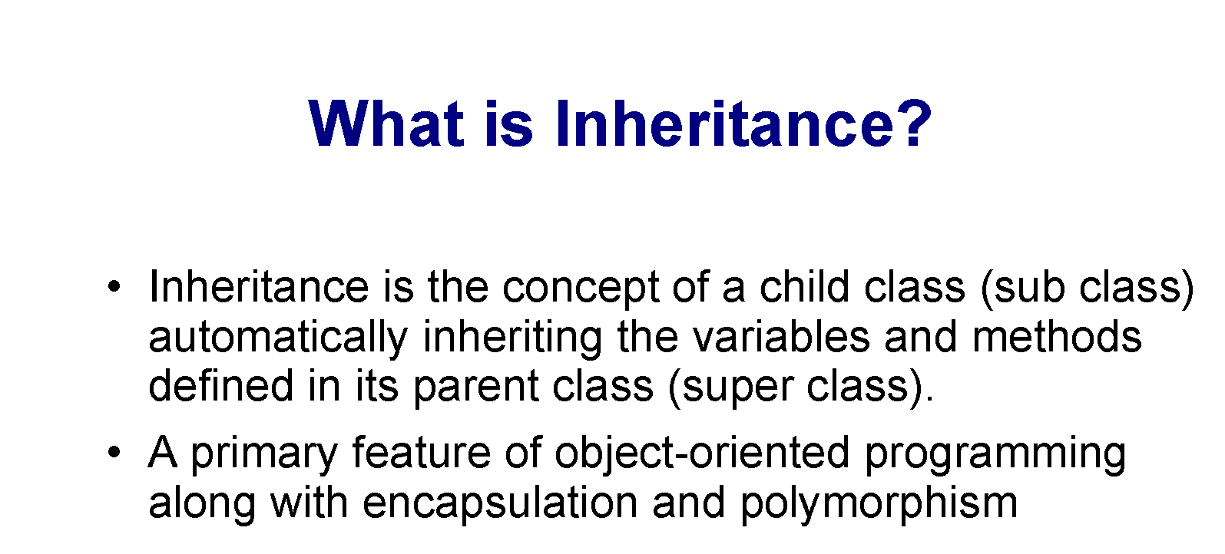

Slide 41
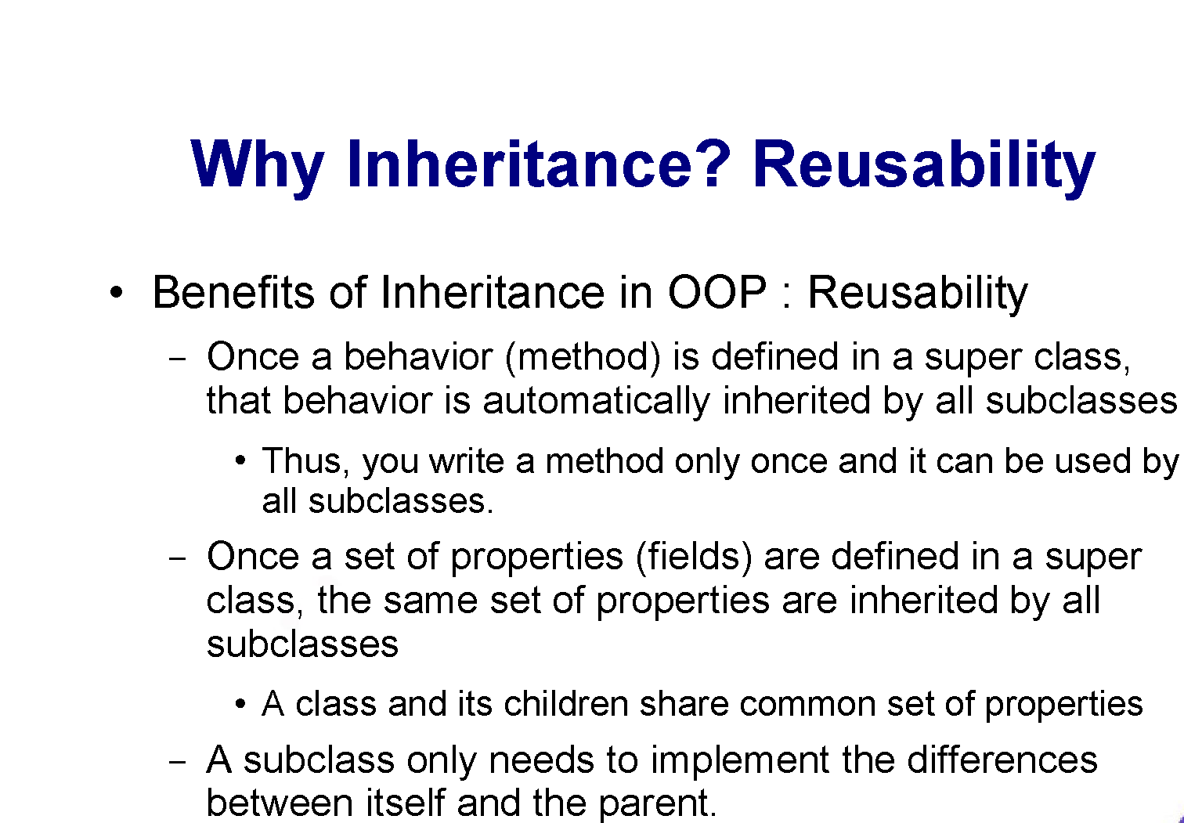

Slide 42
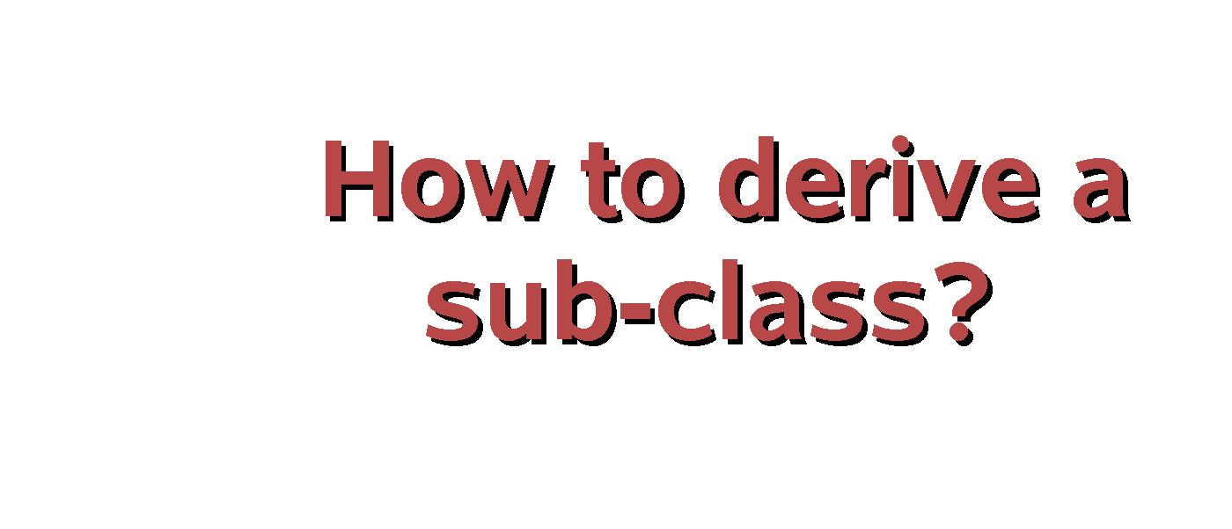

Slide 43
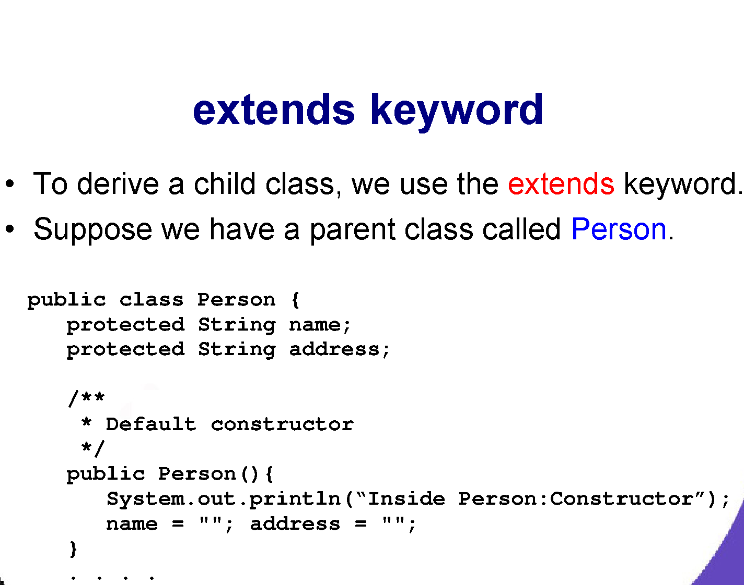

Slide 44
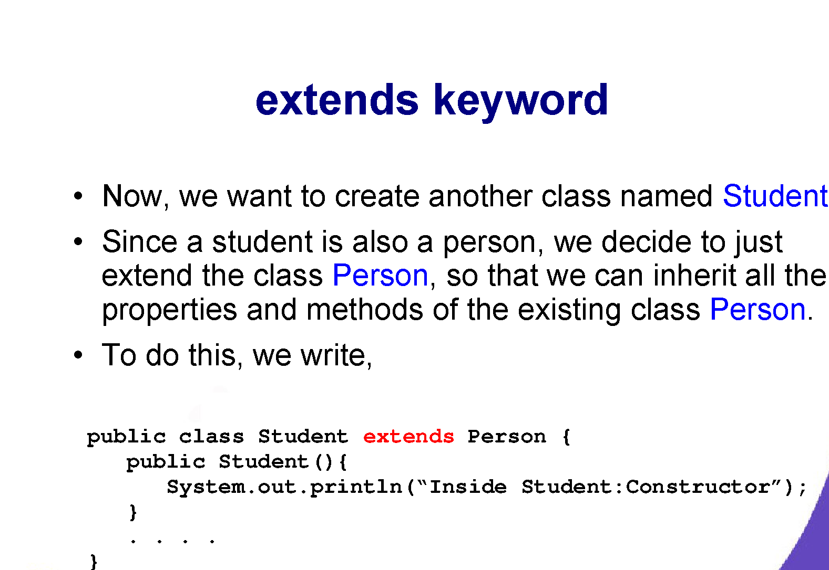

Slide 45
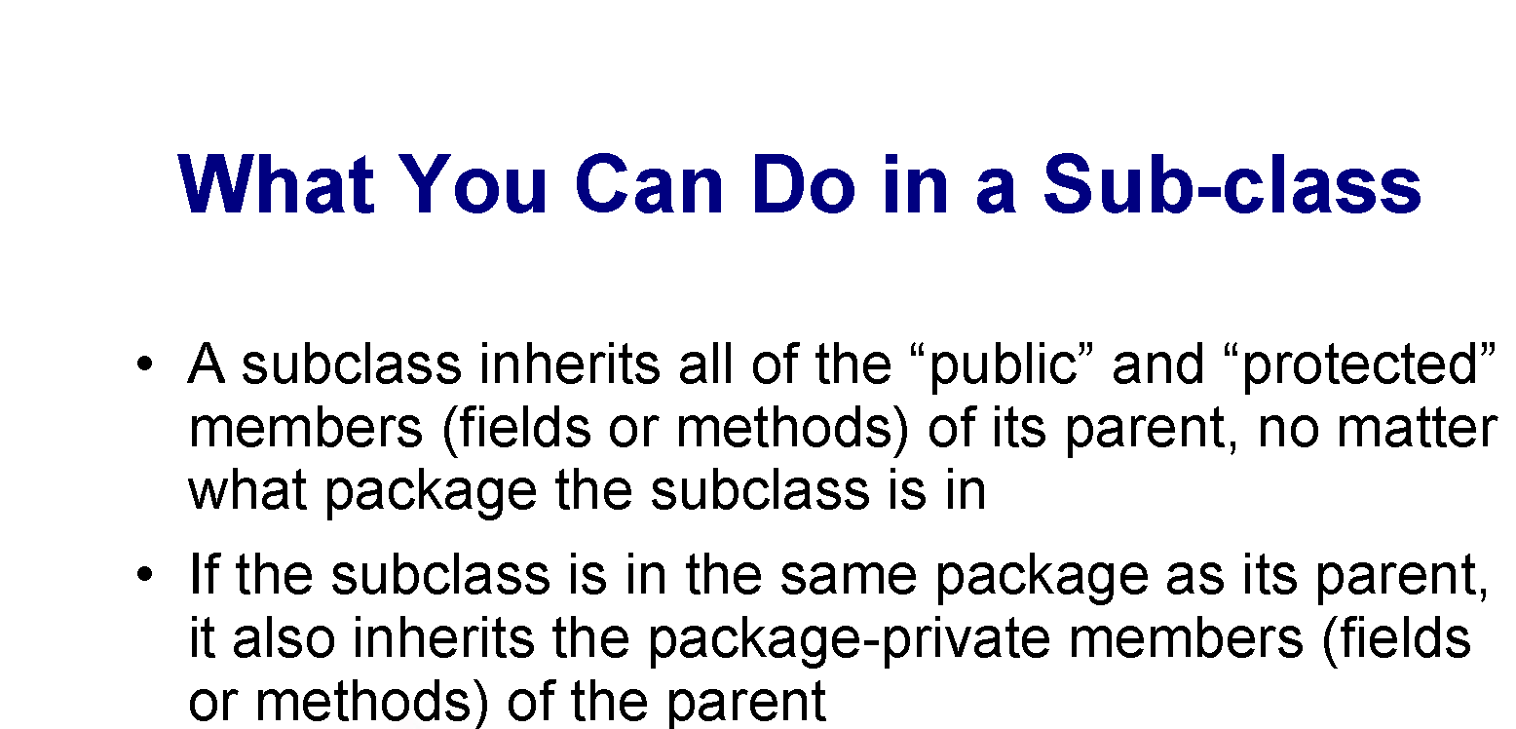

Slide 46
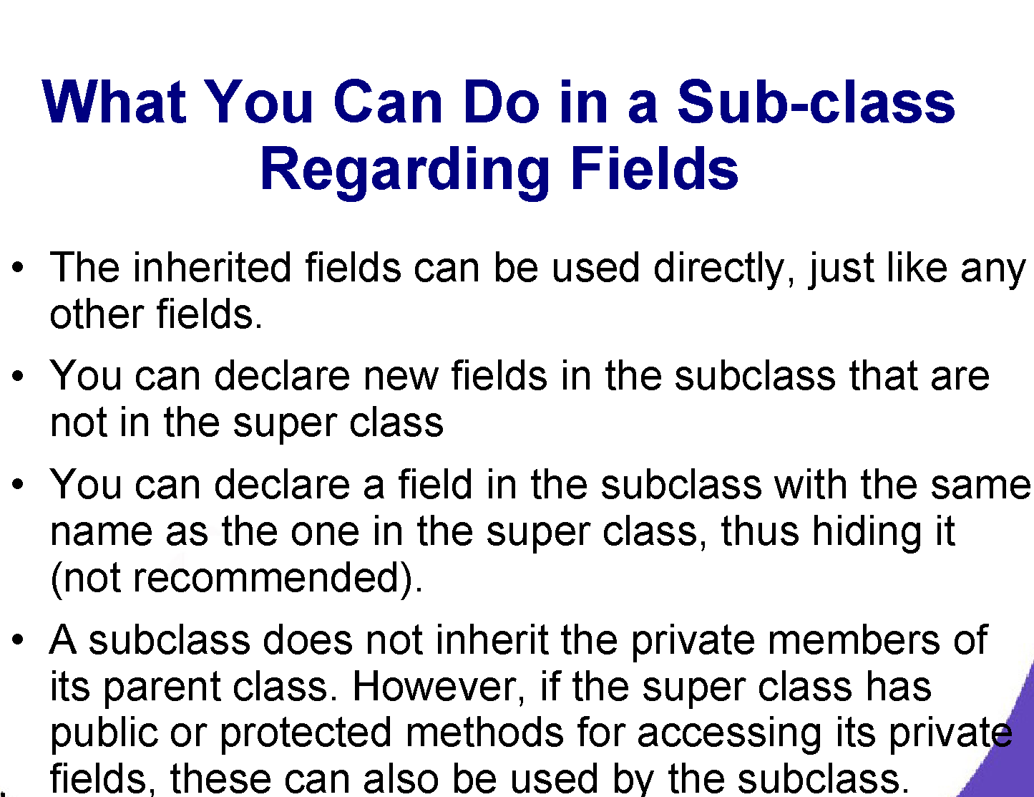

Slide 47
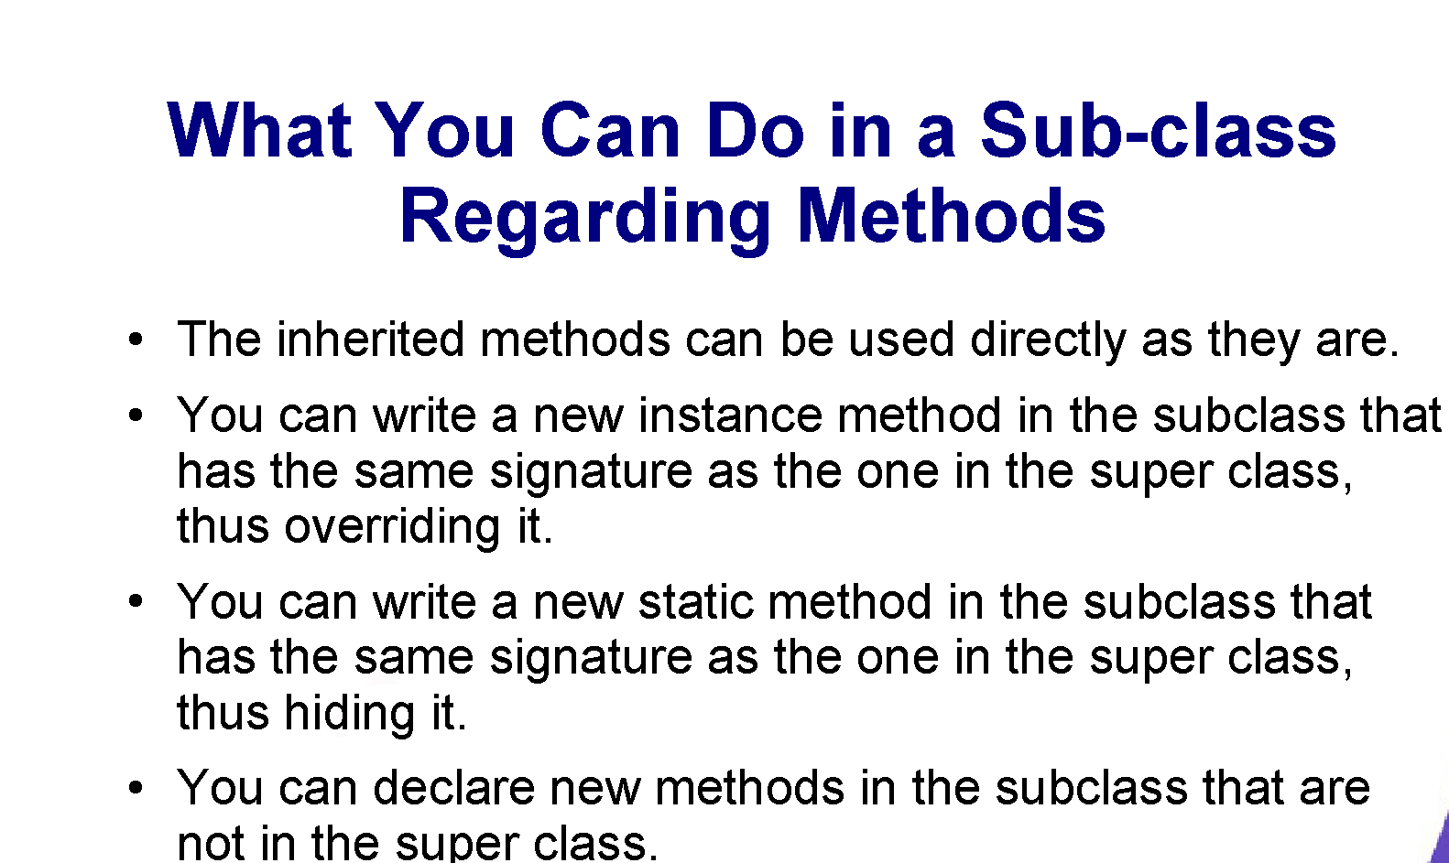

Slide 48
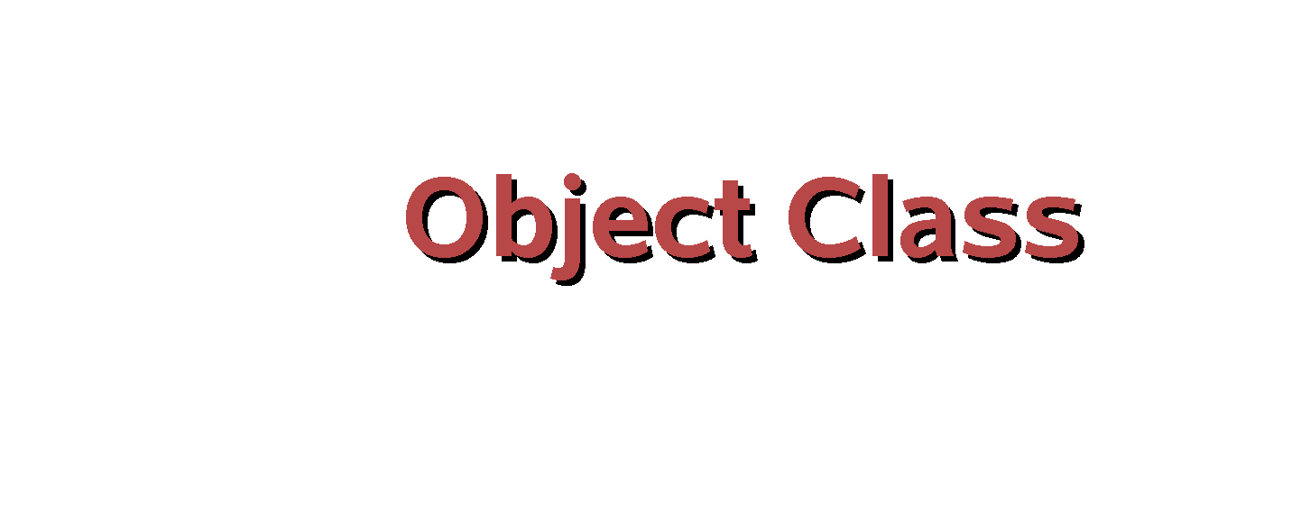

Slide 49
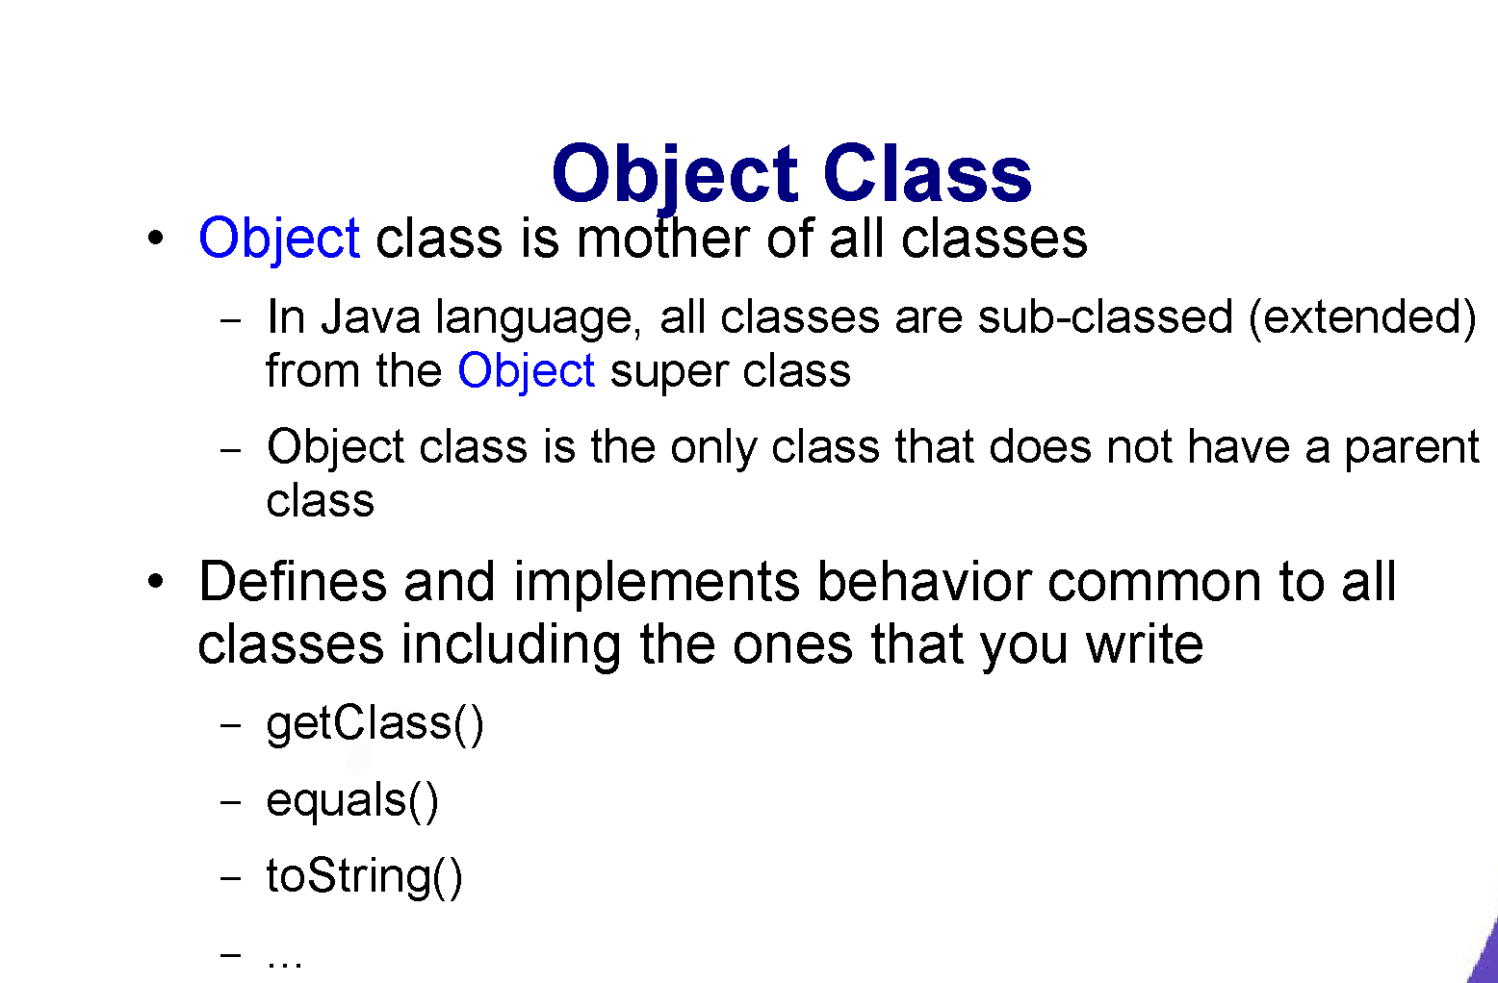

Slide 50
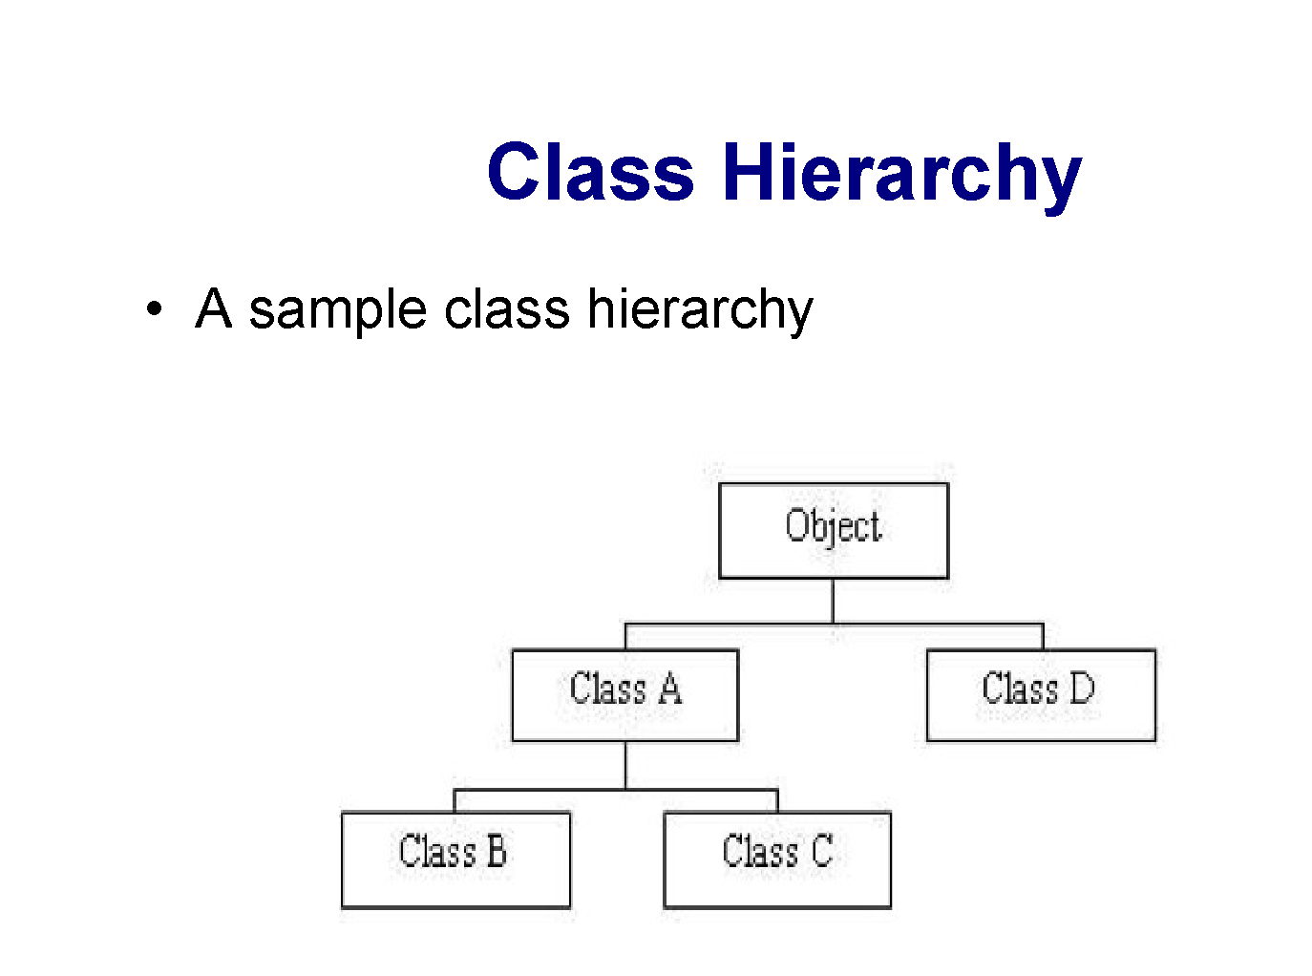

Slide 51
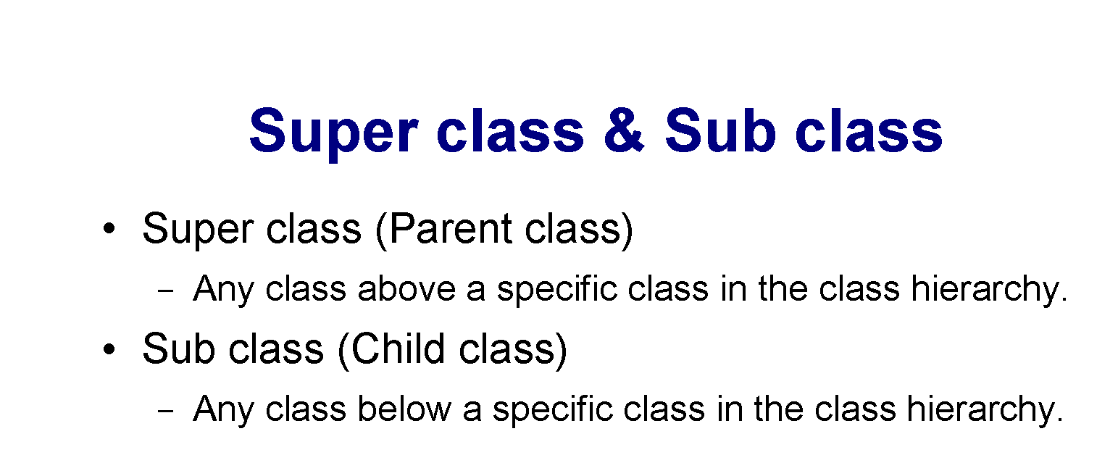

Slide 52
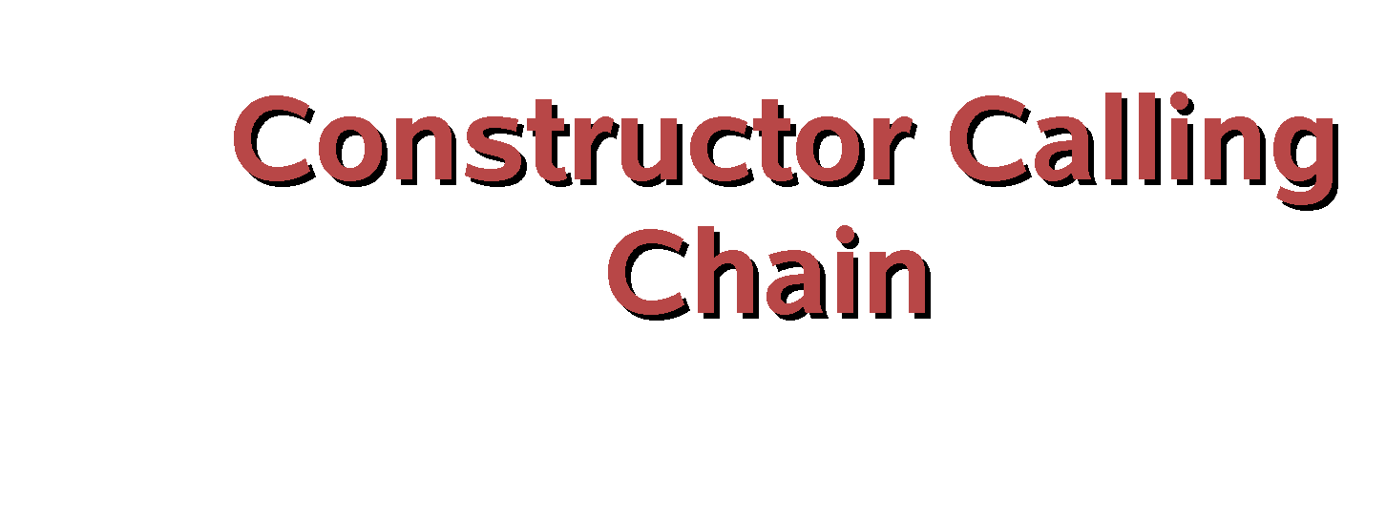

Slide 53
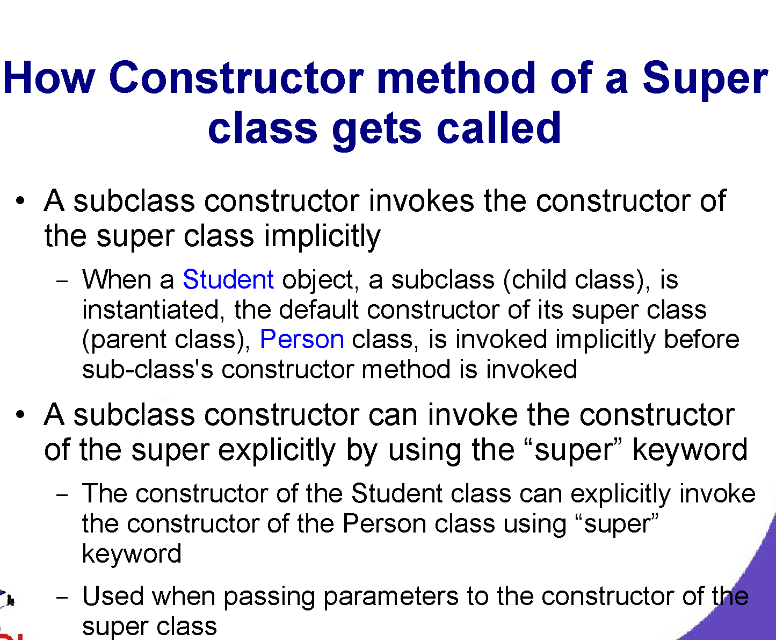

Slide 54
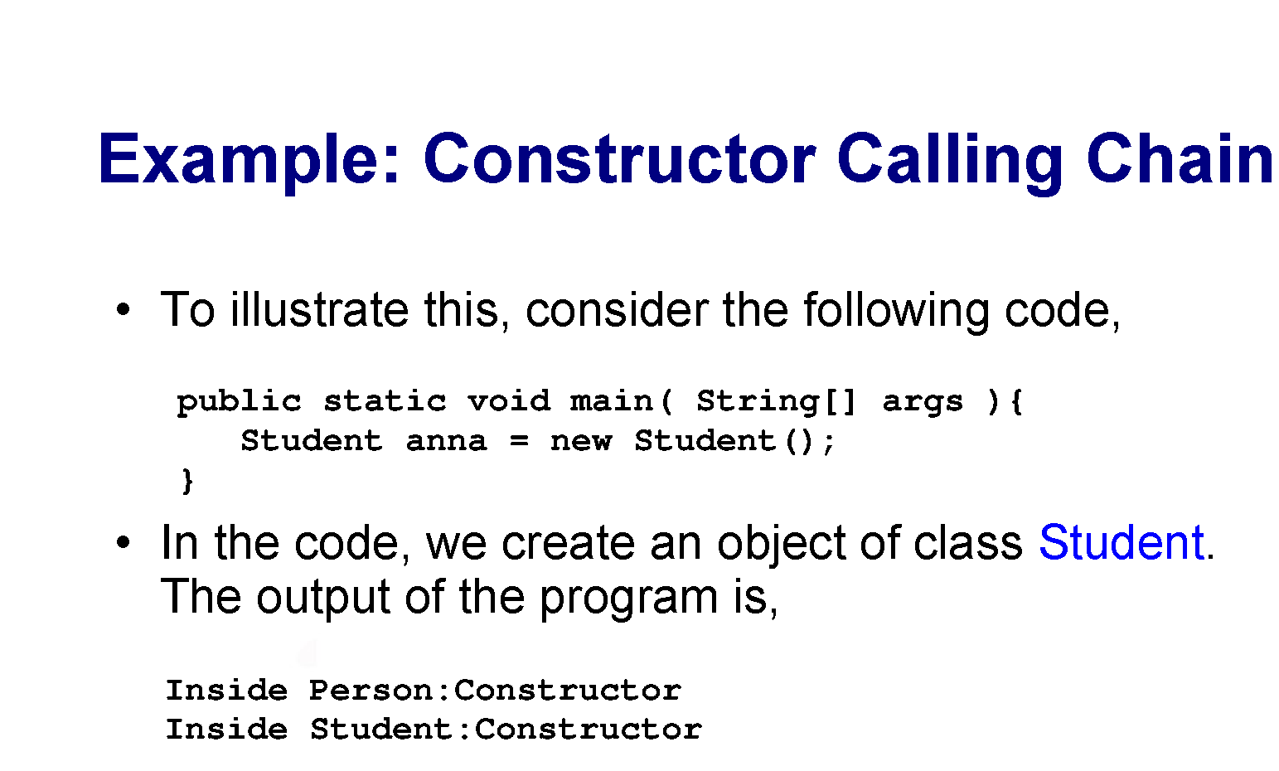

Slide 55
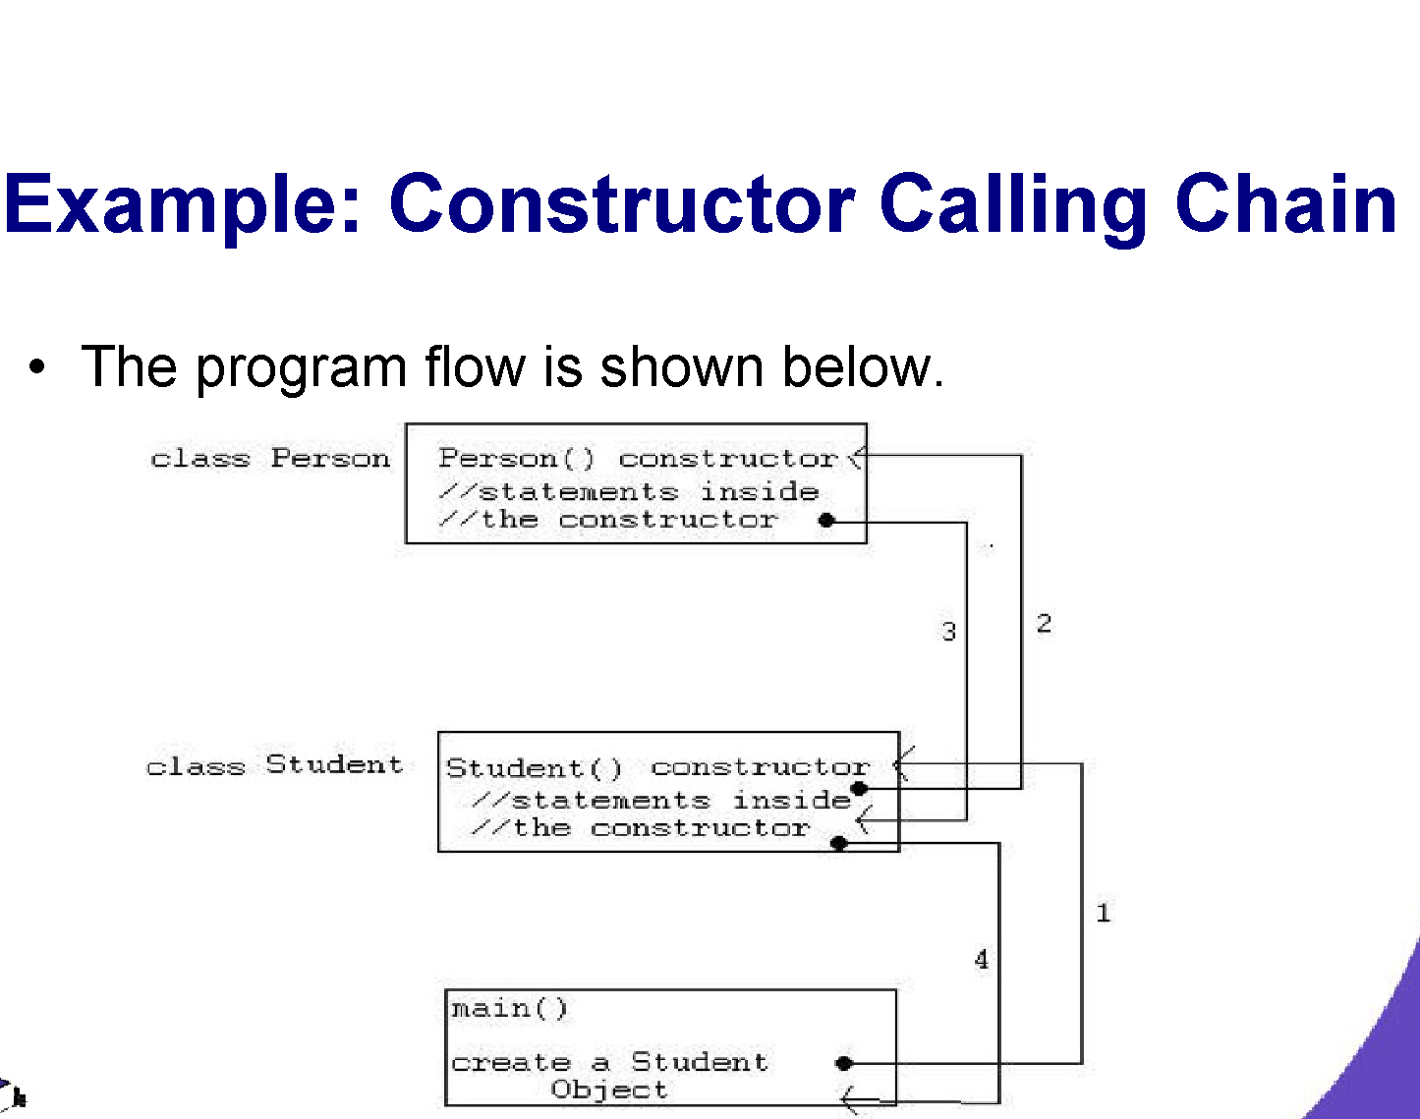

Slide 56


Slide 57
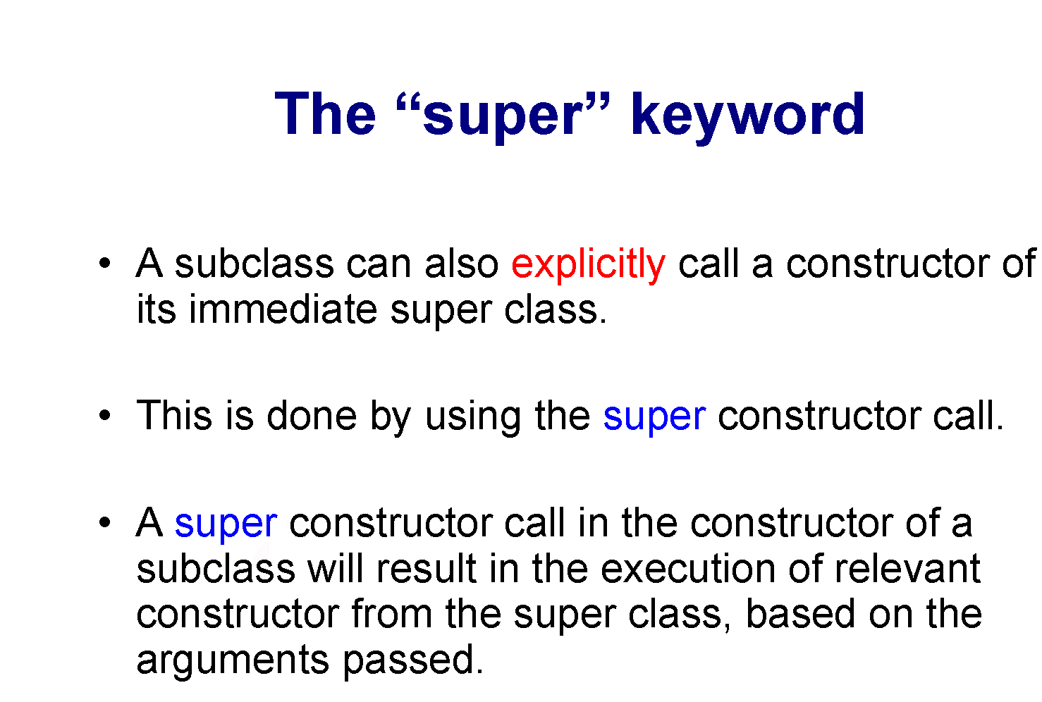

Slide 58
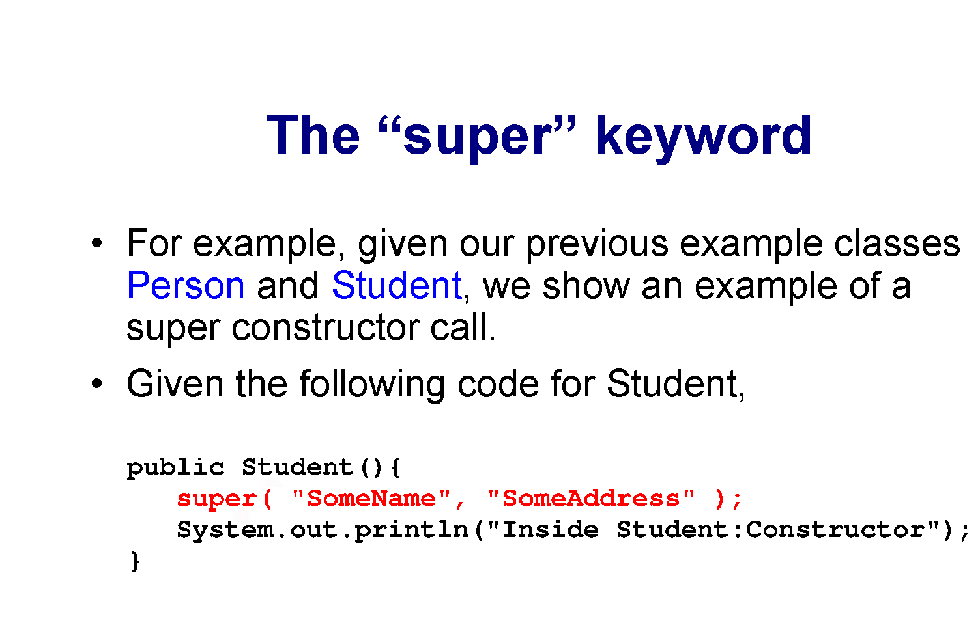

Slide 59
